Slide 1
Citizen Analytics Level 2 Assignment Submission
4th August 2021 Cohort
Prepared by: <Asyraff Fatihin Azhar>
20.10.2021
Open

Slide 2
Title​ | ​Olympics 2020
Objectives​ | ​Analysis on Athletes Coaches, Gender, Medals and Teams
Team Member(s) | Please leave it empty if this is an individual project.
Intended audience/users​ | ​Researcher
Pain points from existing process​ | ​What was/were the pain point(s) from the previous reporting/visualisation process? Did not know how to read and understand the data.
Improvements after dashboard creation​ | ​From your point of view, what are the improvement(s) after dashboard creation? (improved processing time, improved collaboration between different teams/departments, save cost due to the replacement of previous BI Tool) Easy to read and understand data. Instead of seeing in table format, we see it as interesting dashboard. Easy to understand the trend of data. Improved collaboration between different teams when using Power BI services
Way forward plan​ | ​What is your way forward plan to improve your current Power BI dashboard? - Making predictions
Open

Slide 3
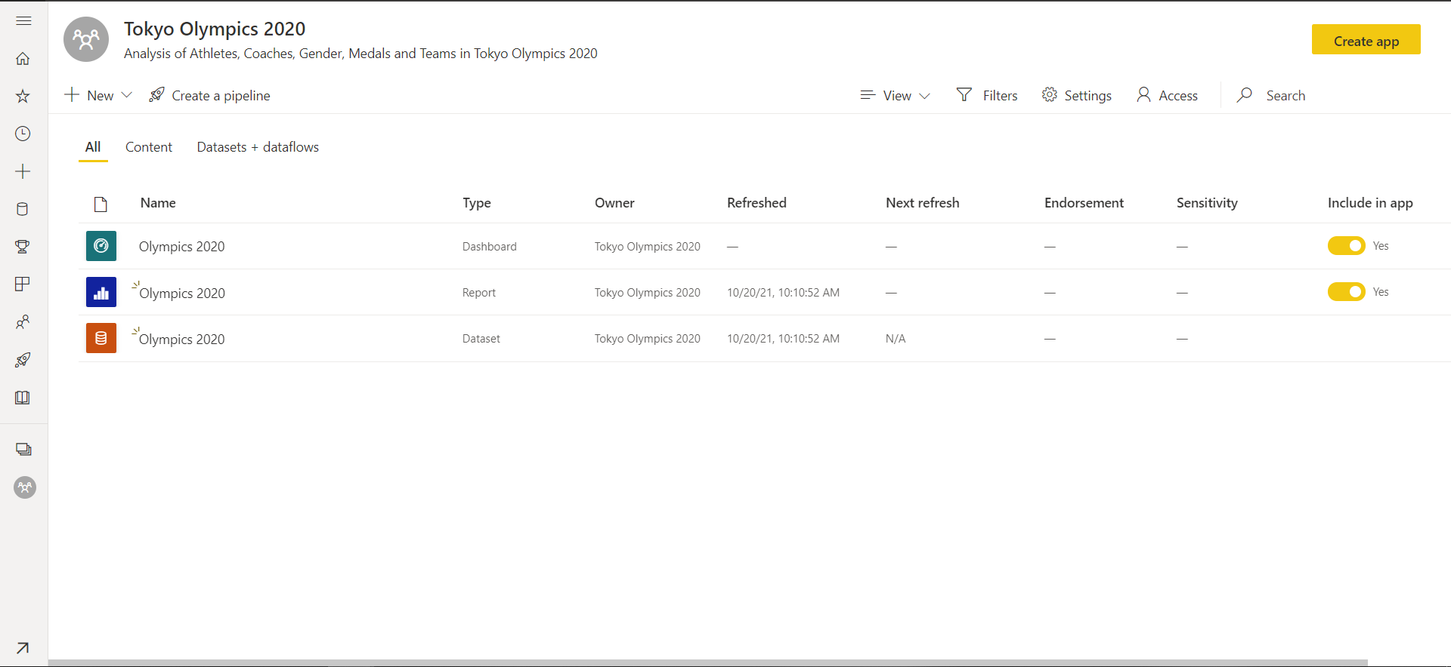
Workspace
Open

Slide 4
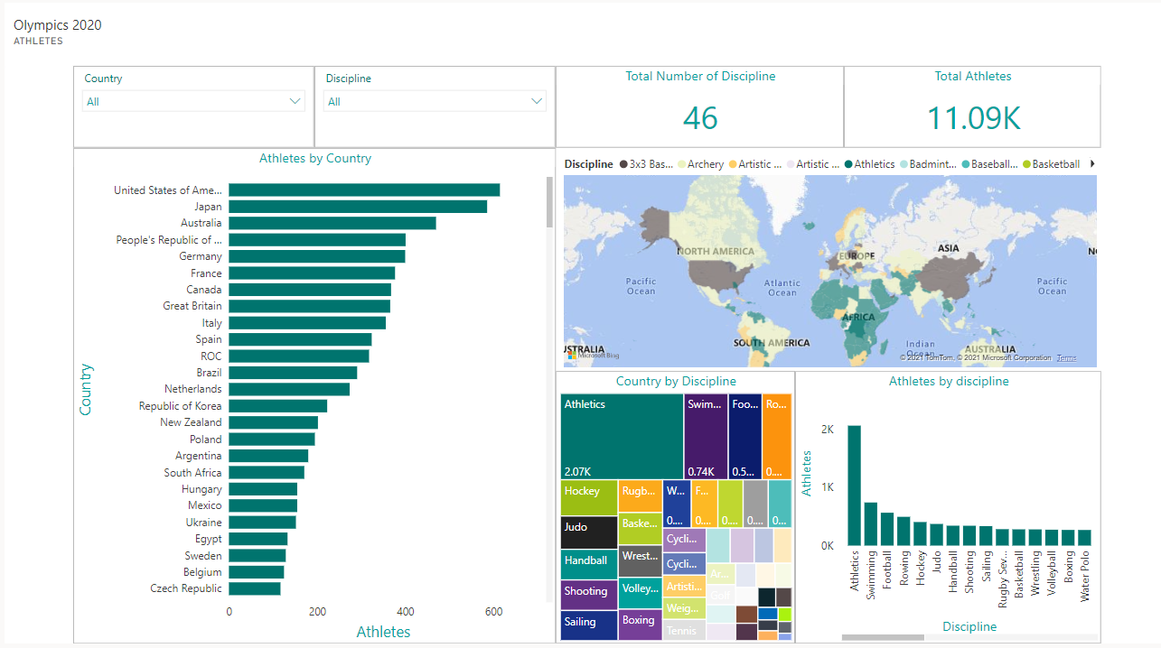
Dashboard (Athletes)
Open

Slide 5
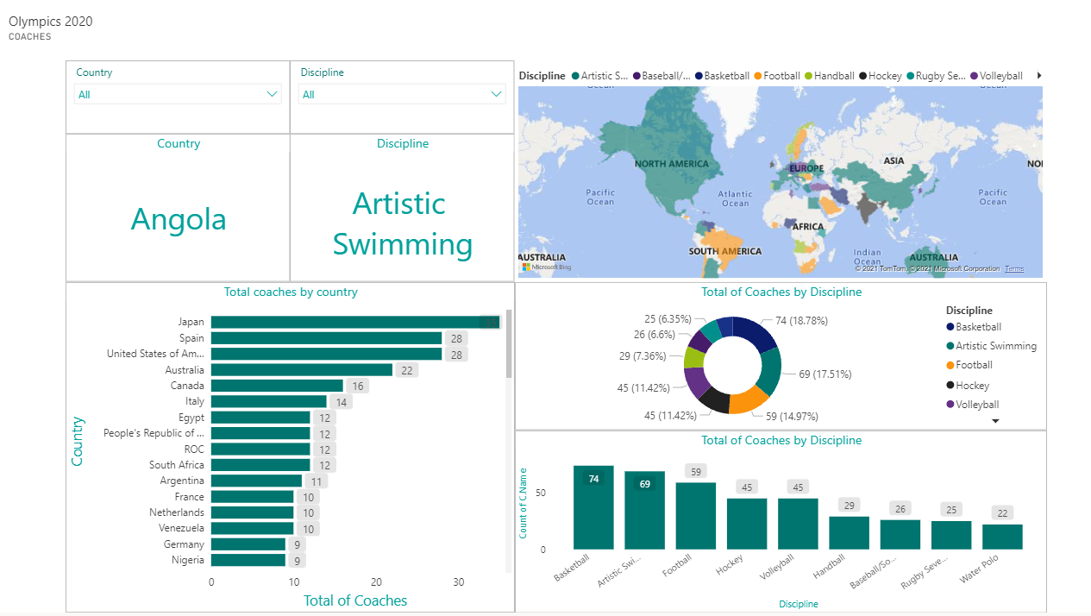
Dashboard (Coaches)
Open

Slide 6
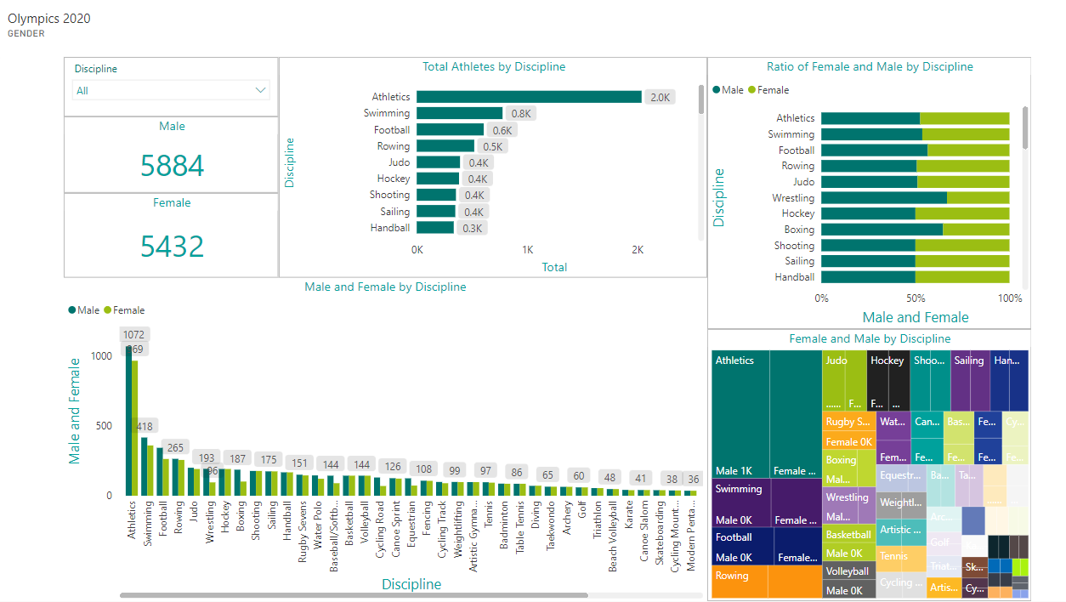
Dashboard (Gender)
Open

Slide 7
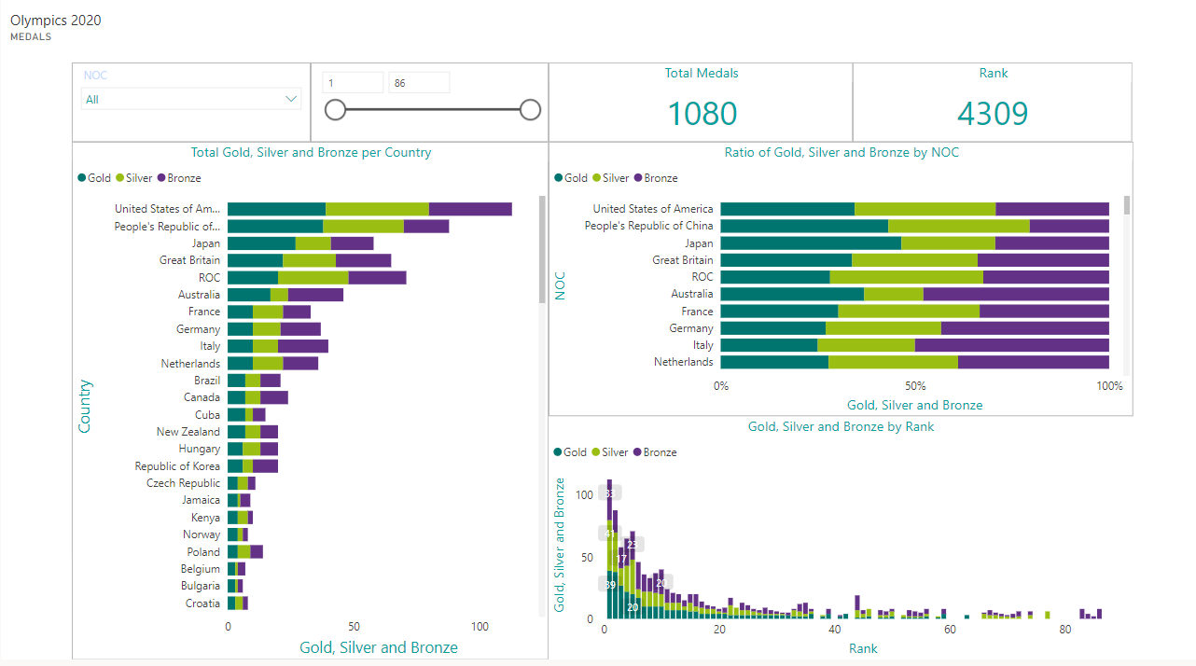
Dashboard (Medals)
Open

Slide 8
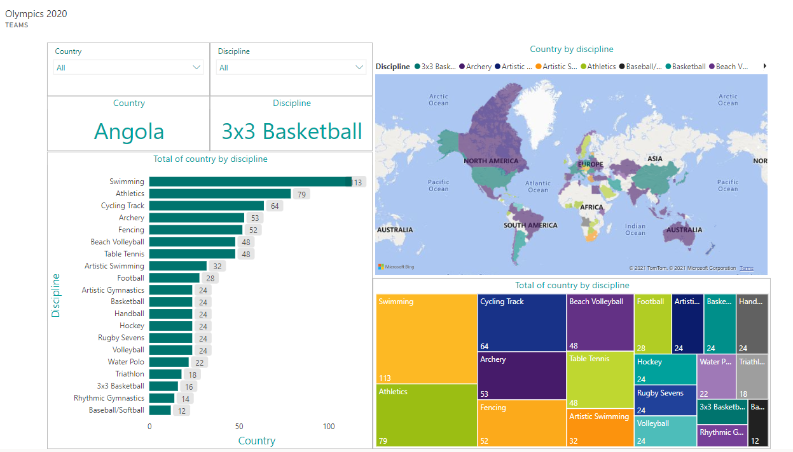
Dashboard (Teams)
Open

Slide 9
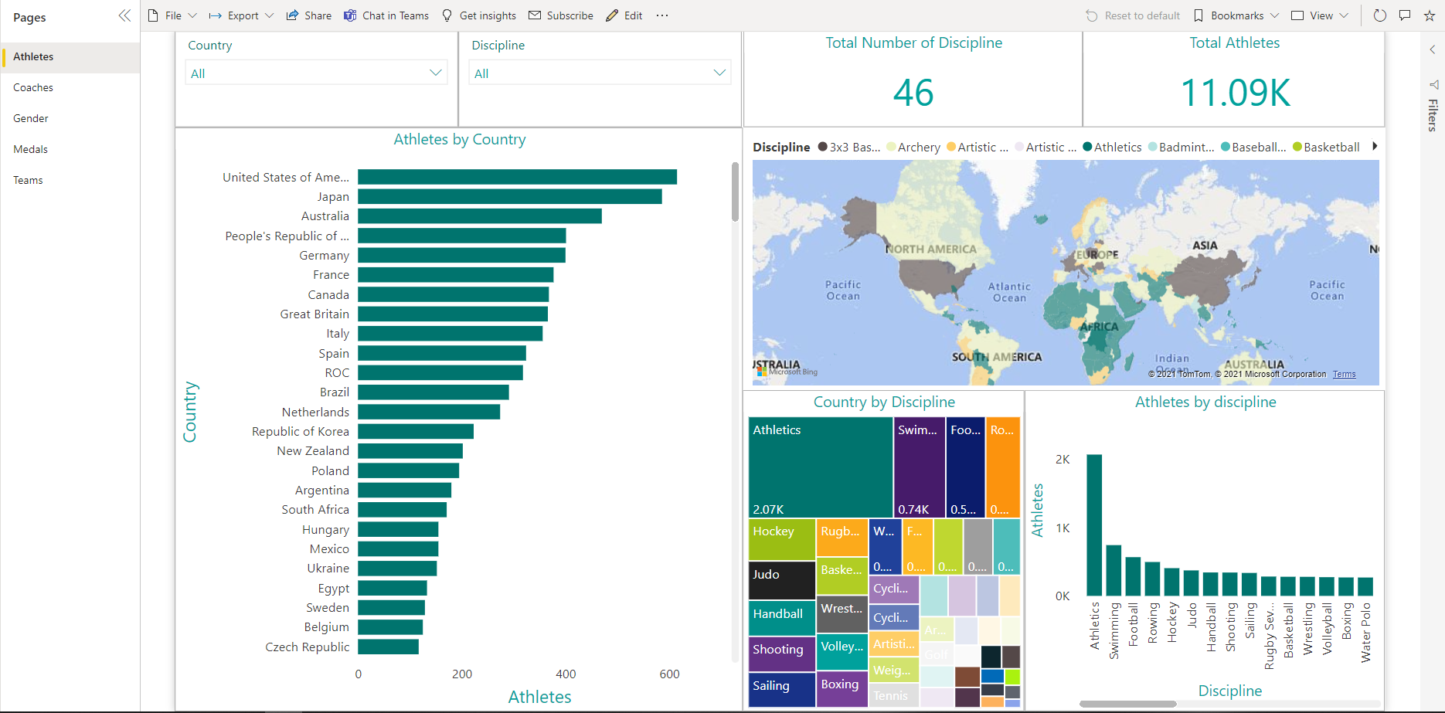
Report (Athletes)
Open

Slide 10
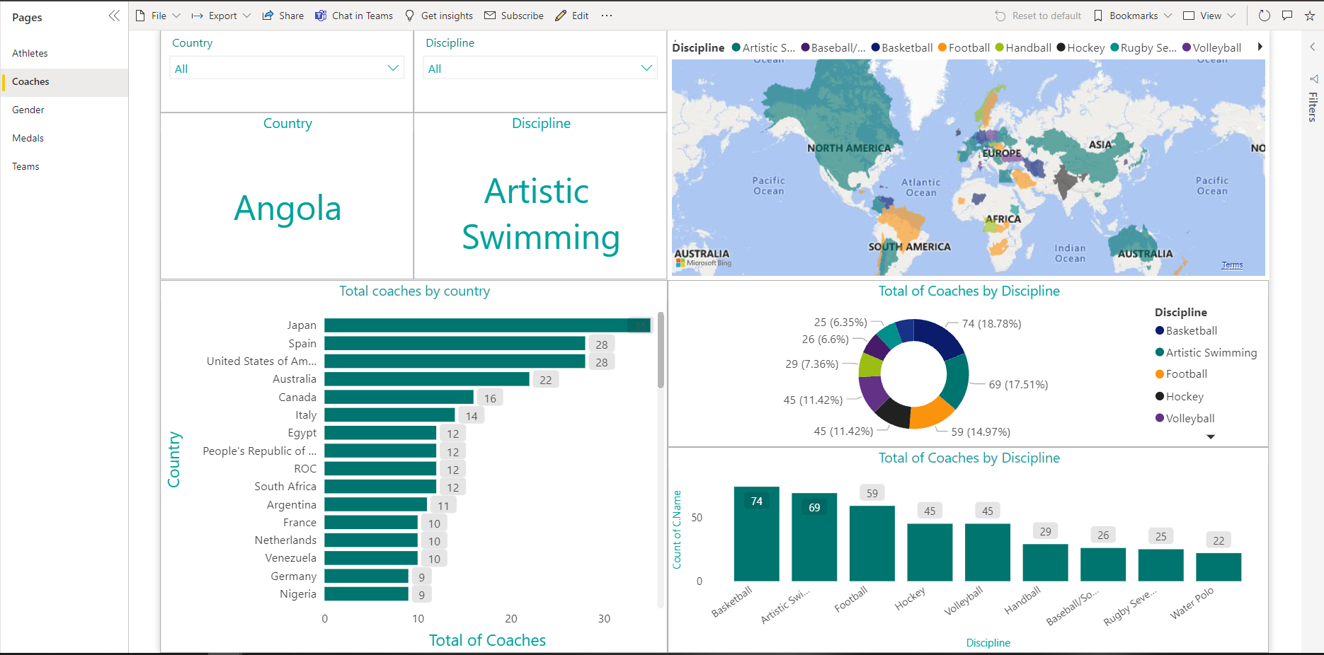
Report (Coaches)
Open

Slide 11
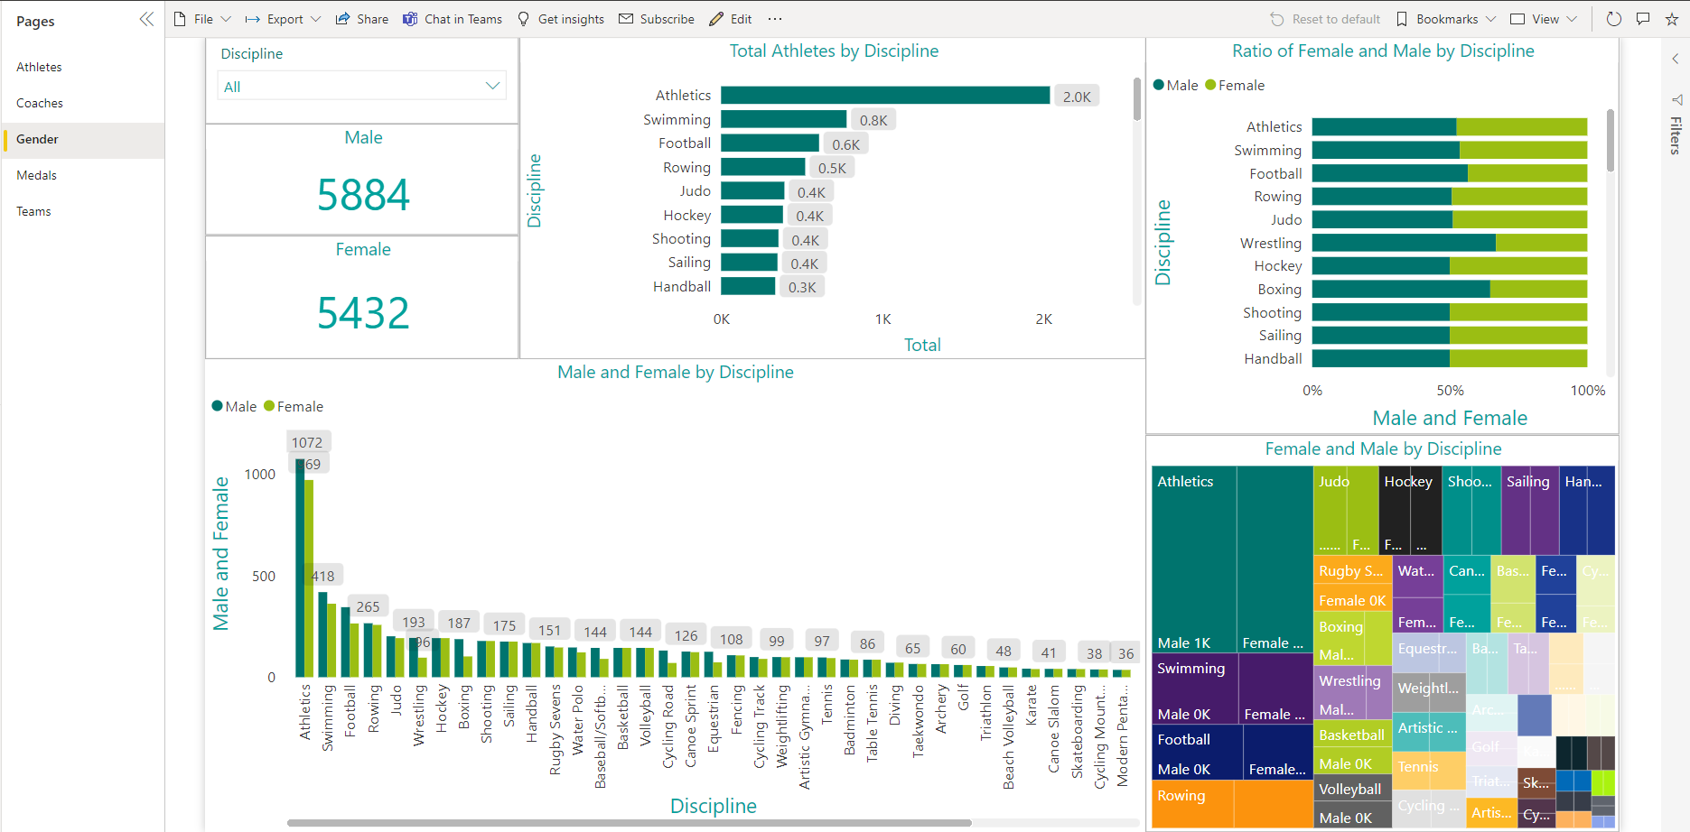
Report (Gender)
Open

Slide 12
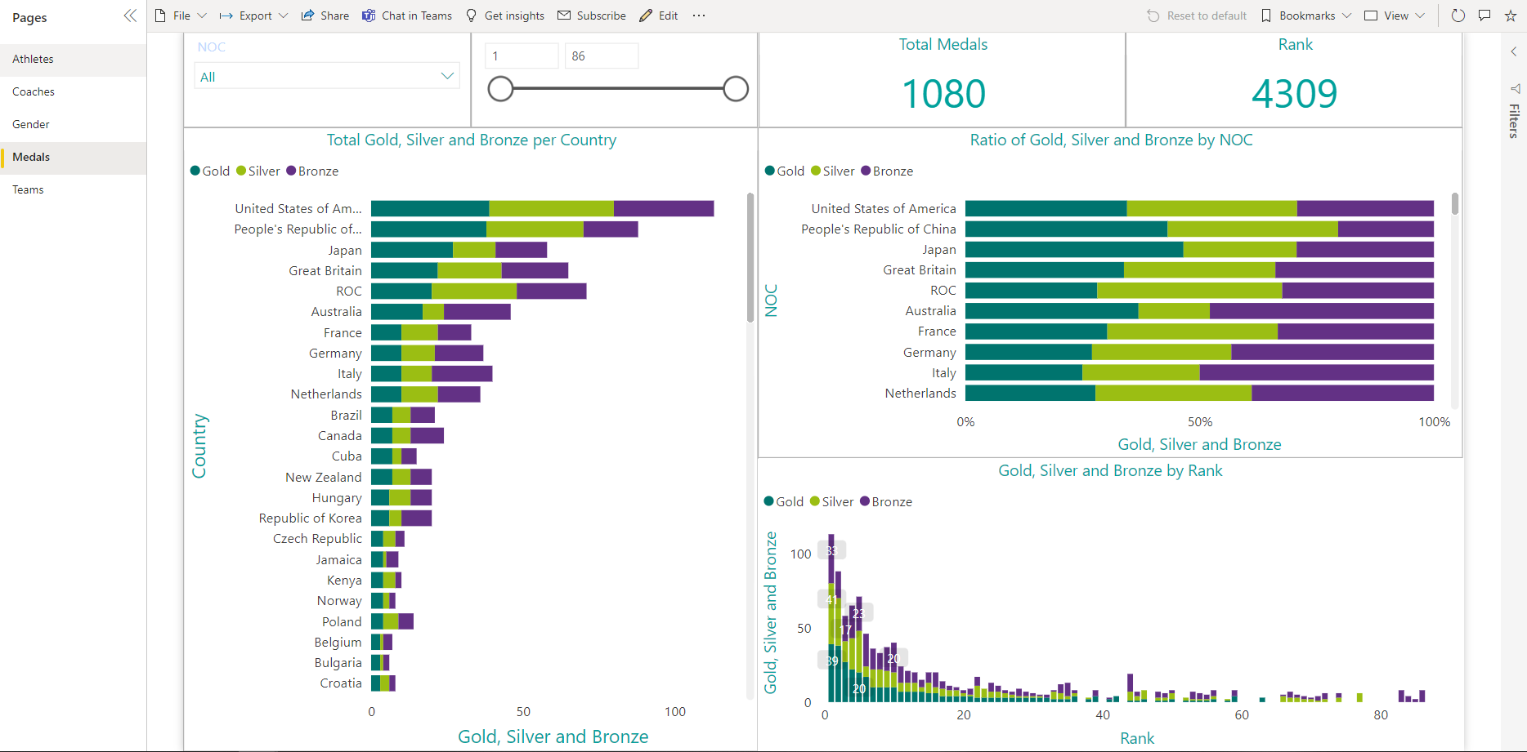
Report (Medals)
Open

Slide 13
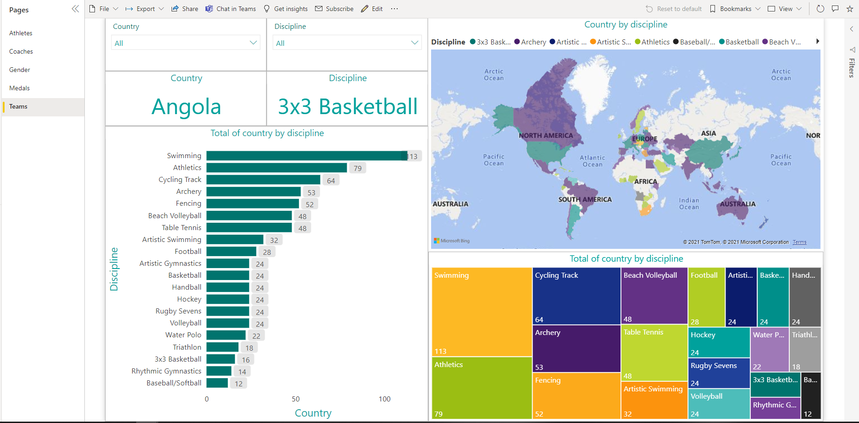
Report (Teams)
Open

Slide 14
Thank you for your passion!
Open

